Slide 1

KGiSL INSTITUTE OF TECHNOLOGY
COIMBATORE
DEPARTMENT OF computer science & engineering
MINI Project review
ONLINE EYE CARE SYSTEM
TEAM 7:
711719104051 MAHESWARAN R
711719104301 AJITHKUMAR S
711719104302 ARUNPRASANTH M
711719104305 MOHANKUMAR S
UNDER THE GUIDANCE OF :
Ms.SUGANTHI A (AP/CSE)

Slide 2

AGENDA
Objective of the project work
Existing System
Proposed System
Expected Outcome
References
Timeline

Slide 3
OBJECTIVE / ABSTRACT
Online eye care system is a special website which makes you aware of your eye problems by making you take test in various sight tests like Visual Acuity Test, Color Variation Test, Contrast Vision Test, Amsler Grid Test, E & C Tests.
Eye check-up application users have to register or login to this application. It can detect your Eye problems by asking few questions like doctors. User answer the question the site will give suggestion about problem.

Slide 4
Literature Survey
TITLE | PUBLICATION YEAR | AUTHOR / PUBLISHER | DESCRIPTION
American Academy of Ophthalmology. Frequency of ocular examinations: | 2019 | AAO Hoskins | The frequency of ocular examinations should be based on the presence of visual abnormalities and the probability of visual abnormalities developing. Individuals who have ocular symptoms require prompt examinations
Self-reported eye care use among US adults aged 50 to 80 years. | 2019 | Ehrlich JR﻿, Ndukwe T﻿, Solway E﻿, et al | To provide nationally representative estimates on self-reported use of eye care by adults aged 50 to 80 years, and to describe the reasons that adults do and do not seek eye care.
Making telemedicine services a reality in eye care, cloud-based referral platform in ophthalmology | 2020 | Dawn A Sim; Dun Jack Fu; Josef Huemer; Tom McKinnon | To assess the clinical utility and diagnostic drifts of a cloud-based referral platform for referrals from community optometrists and hospital-based eye care services.

Slide 5
Literature Survey
TITLE | PUBLICATION YEAR | AUTHOR / PUBLISHER | DESCRIPTION
Imagining eye care in India | 2018 | Taraprasad Das and Lapam Panda | A new approach, that will combine the best of the “old” tradition of empathy and the “new” technology of analytics, is required to imagine the future of eye care in India.
“A Theory of Customer Valuation: Concepts, Metrics, Strategy, and Implementation,” Journal of Marketing, 82 (1), 1–19. | 2018 | Kumar, V. | The concept of customer lifetime value (CLV) as the metric that can provide a reliable, forward-looking estimate of direct customer value.
Eye Care Among US Adults at High Risk for Vision Loss in the United States in 2002 and 2017 | 2020 | Sharon H. Saydah, PhD; Robert B. Gerzoff, MS; Jinan B. Saaddine, MD; et al | Three self-reported measures were visiting an eye care professional in the past 12 months, receiving a dilated eye examination in the past 12 months, and needing but being unable to afford eyeglasses in the past 12 months.

Slide 6
EXISTING SYSTEM
In the existing system is customer go to the clinic and checking eye, doctor's provides suggestion directly. it's all manual process. In a web based application is more difficult to update the suggestion frequently.
It takes more time to complete the process. Even though there are many web based application are available it's all maintain hospital and blood bank based information.
Drawbacks / Pitfalls of the Existing system
Lack of security of data(data may be missing).
More Time consuming.

Slide 7
PROPOSED SYSTEM
The new system is reliable, flexible and accurate with much integrity constraints.
The forms are designed clearly and each entry is recorded in a table.
This system enhances the accuracy based on the users need. Fast, clear and legible reports can be generated without any ambiguity.
Integrated database design and maintenance can be done easily.
Advantages over existing method
This system is user friendly which is running on Web environment.
Provides visual activity.
Large database capacity.
Information can be retrieved very faster.
Records are reliable and accurate.

Slide 8
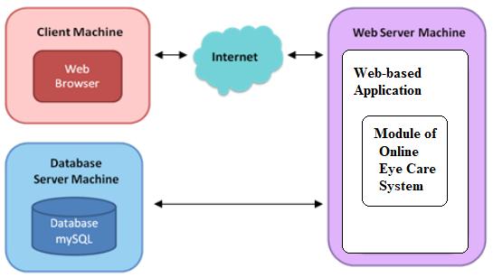
ARCHITECTURAL DIAGRAM

Slide 9
Modules split up
USER REGISTRATION:-
Existing user can login by using their username and password. A new user has to do the registration process to access the application in online. User can view the test menu which is posted by the admin. The registration process includes username, password, address, phone etc.
VIEW ACTIVITY:-
With the help of this system user can view the available test details which includes visual activity test, color variation test, contrast sensitivity, amsler’s grid test, and Myopia test. These activities are updated to test the user’s eye sight variation.

Slide 10
Modules split up
TEST:-
The registered user can participate the tests in online.. These test are conducted by level based .if one test is completed another will carried automatically to the users site within a fraction of seconds.
SUGGESTING RESULTS:-
These are all generated based on their performance in the entire tests that we mentioned earlier in the activity module. Result statement includes the eye problems of the user such as long sight, short sight etc
FORUM:-
It provides interactivity between the user and the admin. If a user needs to have a clarification about the suggested result; He/she can send a query to the admin regarding the result provided by this site or their eye issues.

Slide 11
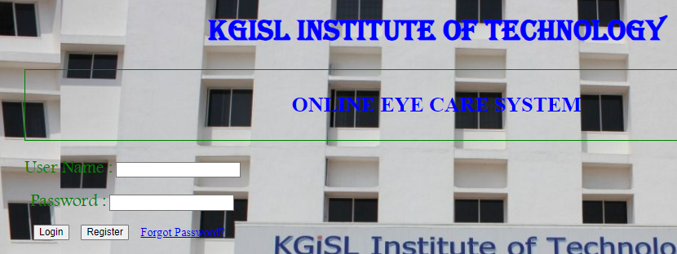
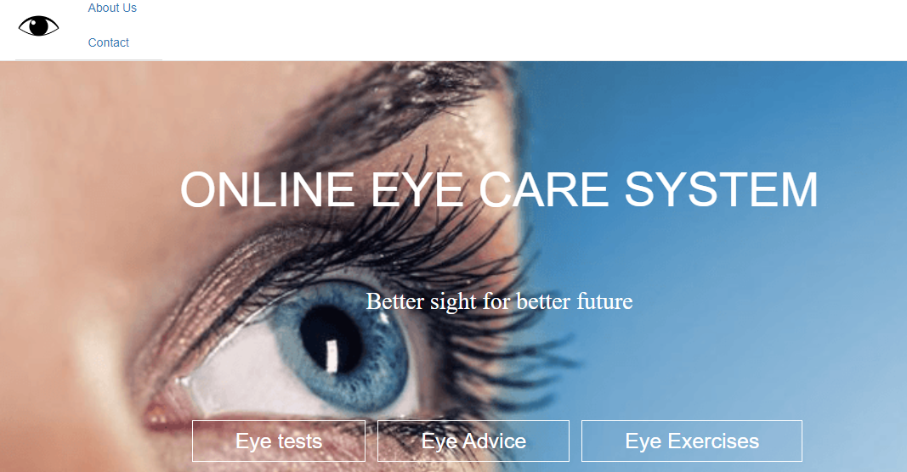
SCREENSHOTS

Slide 12
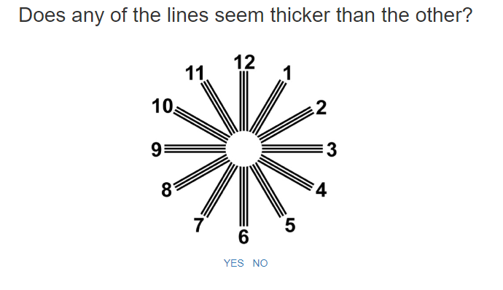
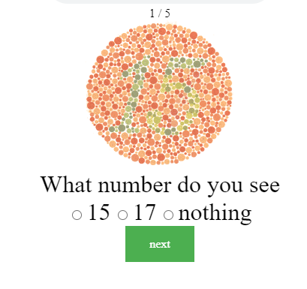
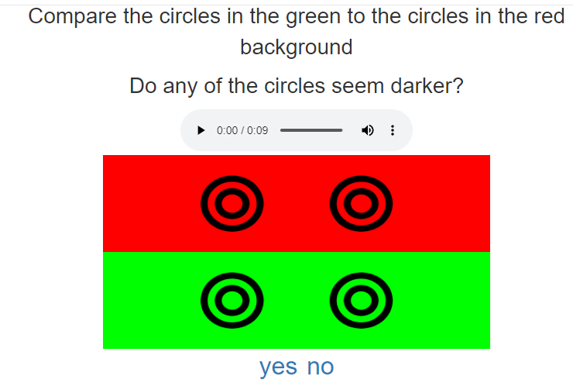

Slide 13
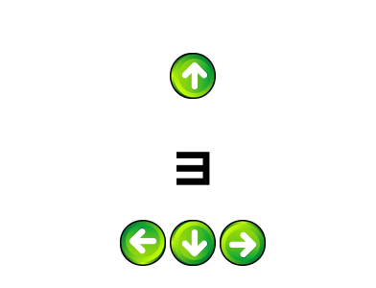
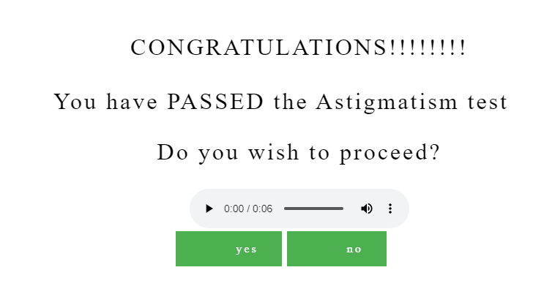
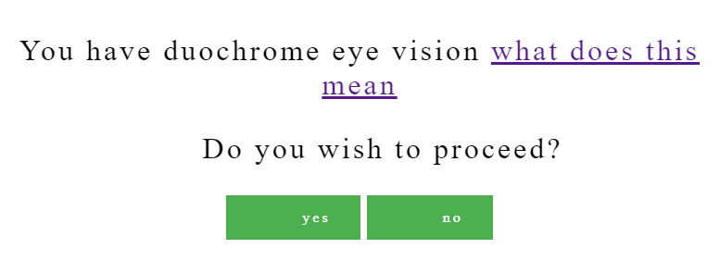

Slide 14
EXPECTED OUTCOME
The project aims to eye check-up application can detect your Visual acuity and the site will given results about your vision ability.
This project automatically maintains the customer details and it provides information concerning eye, and decides whether problem of eye and suggestion.
This system stores details of the customers and eye question through online.

Slide 15
CONCLUSION
It is concluded that the web application works well and satisfy the end users. The application is simultaneously accessed from more than one system. This project is to bring a full-fledged web based eye test systems. This system enhances the accuracy based on the users need. Fast, clear and legible reports can be generated without any ambiguity.

Slide 16
feature enhancement
There is scope for future development of this project. The world of computer fields is not static; it is always subject to be dynamic.It has future scope. Online Eye care system is to made for all the peoples have to check their eye test in online.

Slide 17
REFERENCE
[1] Elias M.Award, ”System Analysis and Design”, Galgotia Publications, Second Edition.
[2] Robin Dewson, “Pro SQL Server 2005”, Apress Publisher.
[3] Paul Kimmel, “Asp.Net-Unleased”, Sams TechMedia, Third Edition.
[4] Wittenborn J﻿, Rein D﻿; NORC at the University of Chicago. Cost of vision problems: the economic burden of vision loss and eye disorders in the US.Published February 5,2020. https://www.preventblindness.org/sites/default/files/national/documents/Economic%20Burden%20of%20Vision%20Final%20Report_130611_0.pdf

Slide 18
REFERENCE
[5] Yeung WK, Dawes P, Pye A, Neil M, Aslam T, Dickinson C, et al. eHealth tools for the self-testing of visual acuity: a scoping review. NPJ Digit Med. 2019;2:82 Epub 2019/08/28. 10.1038/s41746-019-0154-5
[6] Kemp MT, Williams AM, Alam HB. Trauma Surg Acute Care Open 2020;5:e000481 10.1136/tsaco-2020-000481
[7]Shilo S, Rossman H, Segal E. Axes of a revolution: challenges and promises of big data in healthcare. Nat Med. 2020;26: 29–38. Epub 2020/01/15. 10.1038/s41591-019-0727-5
[8]Ting DSW, Carin L, Dzau V, Wong TY. Digital technology and COVID-19. Nat Med. 2020;26: 459–461. Epub 2020/04/15. 10.1038/s41591-020-0824-5
[9]Leite Higor, Hodgkinson Ian R. & Gruber Thorsten (2020) New development: ‘Healing at a distance’—telemedicine and COVID-19, Public Money & Management, 10.1080/09540962.2020.1748855

Slide 19
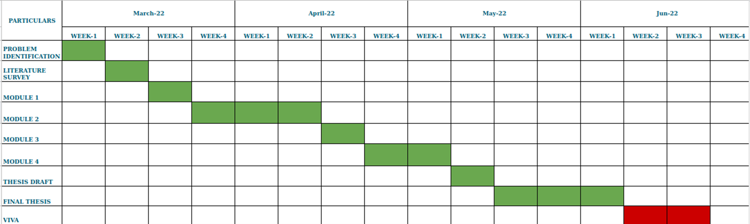
TIMELINE

Slide 20
THANK YOU

